Slide 1
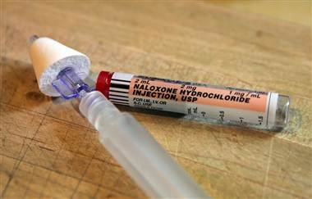
Suffolk County Police Department
EMT Intranasal Naloxone (Narcan)®
²⁰¹³
^{Training Update}
Notes:
Narrative
The BLS Narcan Pilot Project is a collaborative effort between the New York State Department of Health, the Bureau of EMS, Albany Medical Center, AIDS Institute, Suffolk REMSCO, Harm Reduction Coalition, and the Suffolk County Police Department.
This pilot project will allow Police Officers to save lives by administering a life-saving medication Narcan.
The bottom line:
Opiod drugs can make a person stop breathing.
Naloxone (Narcan) is a safe medication to administer.
Administering intranasal Narcan is easy.

Slide 2
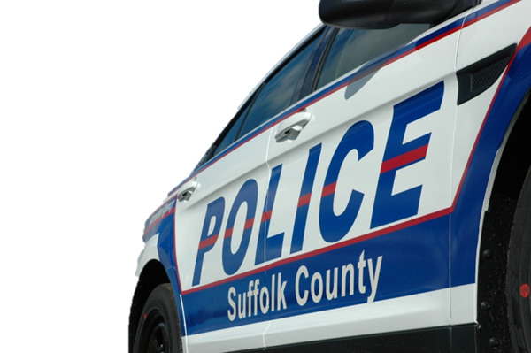
Acknowledgements
New York State Department of Health
NYS DOH, Bureau of EMS
Regional Emergency Medical Organization
Suffolk County REMSCO
Scott S. Coyne, M.D., Medical Director, Chief Surgeon SCPD
Dr. Michael Dailey, NYS DOH
Suffolk County EMS
AIDS Institute
Albany Medical Center
Harm Reduction Coalition

Slide 3
Suffolk County Vital Statistics
Suffolk County Medical Examiner's Office Yvonne Milewski M.D., Chief Medical Examiner Michael Lehrer, Ph.D., Chief Toxicologist Heroin and Other Opiate Deaths 2004 - 2011 Drug Appears in Cause of Death
 | 2004 | 2005 | 2006 | 2007 | 2008 | 2009 | 2010 | 2011
Heroin | 32 | 51 | 41 | 34 | 42 | 47 | 37 | 64
Oxycodone | 24 | 24 | 31 | 40 | 23 | 40 | 58 | 90
Hydrocodone | 25 | 15 | 22 | 29 | 21 | 18 | 17 | 17
Codeine | 1 | 3 | 3 | 2 | 1 | 1 | 3 | 2
Morphine | 13 | 12 | 15 | 20 | 28 | 19 | 21 | 27
Buprenorphine | 0 | 0 | 1 | 0 | 1 | 0 | 0 | 1
Fentanyl | 10 | 11 | 8 | 14 | 7 | 17 | 11 | 16
Dihydrocodeine | 0 | 0 | 0 | 0 | 0 | 0 | 0 | 0
Methadone | 27 | 24 | 29 | 37 | 34 | 25 | 22 | 26
Hydromorphone | 2 | 4 | 1 | 2 | 4 | 3 | 1 | 2
Oxymorphone | 1 | 3 | 4 | 0 | 0 | 2 | 8 | 17
Total non-Heroin | 103 | 96 | 114 | 144 | 119 | 125 | 141 | 198
Notes:
The Statistics are alarming. According to the Suffolk County Medical Examiners Office: In Suffolk County alone, there have been 348 Heroin Deaths, and 1,040 deaths related to opiate overdoses from 2004 to 2011.

Slide 4
Suffolk County Vital Statistics All drug related deaths in the 1st Quarter of 2012
According to the Suffolk County Medical Examiner’s Office
Of the total deaths, 21 were females and 47 were males.
Age Group | Drug Deaths |  | Town | Deaths |  | Race | Deaths
Under 20 years | 3 |  | Babylon | 8 |  | Black | 1
20 – 29 years | 14 |  | Brookhaven | 24 |  | Caucasian/White | 65
30 – 39 years | 13 |  | East Hampton | 1 |  | Hispanic | 2
40 – 49 years | 12 |  | Huntington | 8 |  | Other | 0
50 – 59 years | 18 |  | Islip | 15
60 and above | 8 |  | Riverhead | 3
 |  |  | Shelter Island | 0
 |  |  | Smithtown | 7
 |  |  | Southampton | 1
 |  |  | Southold | 1
Totals | 68 |  | Totals | 68 |  | Totals | 68
Notes:
In the first 3-months of 2012, there have been 68 deaths due to opiate overdoses. With a large number occurring in the Towns of Brookhaven and Islip.

Slide 5
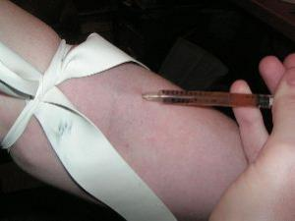
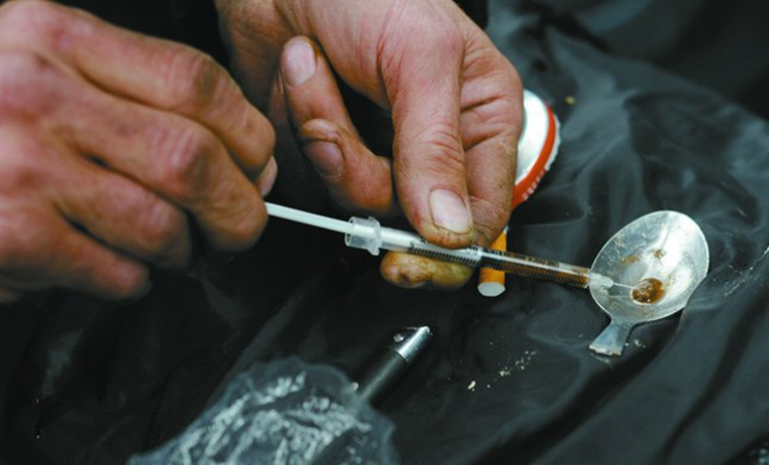
Opiate Overdoses are Becoming an Epidemic in Suffolk County. WHY?
Heroin is cheaper and more pure
Heroin is derived from the poppy plant
IV Heroin peaks in serum in 1-minute
There is an increased use of prescription drugs
Notes:
WHY are there so many overdoses related to opiates?
Heroin is cheap and highly addictive. People of all ages and socio-economic backgrounds are not resistant to this plague. After dip in 80’s opiate abuse has increased since 90’s. The heroin of the 80’s was <10% pure making injection the only way to get high.
Dealers are now distributing heroin that is >60% pure allowing people to snort it to get high.

Slide 6
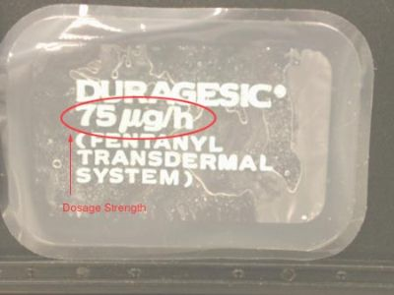
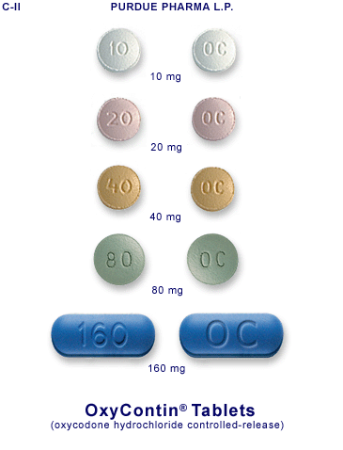
Opiates of Abuse
Opium
Codeine
Morphine
Tramadol (Ultram)
Methadone
Buprenorphine (Subutex)
Propoxyphene (Darvocet)
Pethidine (Demerol)
Hydrocodone (Lortab/Vicodin)
Oxycodone (Percocet, Oxycontin)
Hydromorphone (Dilaudid)
Oxymorphone (Opana)
Fentanyl
(Illegal) Heroin (diacetylmorphine)
Notes:
Some commonly used schedule II Controlled Substances include:
Opium
Codeine
Morphine
Tramadol (Ultram)
Methadone
Buprenorphine (Subutex)
Propoxyphene (Darvocet)
Pethidine (Demerol)
Hydrocodone (Lortab/Vicodin)
Oxycodone (Percocet, Oxycontin)
Hydromorphone (Dilaudid)
Oxymorphone (Opana)
Fentanyl

Slide 7
Opiate Overdose Signs and Symptoms
PINPOINT PUPILS
Respiratory Depression
CNS Depression
Notes:
So what signs and symptoms do we look for when a person overdoses on an opiate?
Miosis or pin-point pupils.

Slide 8
Typically, When Does an Overdoses Occur?
High potency heroin (Injected or Inhaled)
Poly-substance overdose-typically alcohol and benzodiazepines in addition to heroin.
Decreased tolerance after period of abstinence; release from jail, relapse after detox/recovery.
Notes:
Overdoses occur when the patient injects or snorts high potency heroin.
Or
When a person takes alcohol, benzodiazepines (Valium) in addition to heroin can cause someone to overdose because valium, alcohol, and heroin all cause respiratory and CNS depression.
Or
Persons who have a decreased tolerance after abstinence, such as release from jail, or relapse after detox or recovery.

Slide 9
Frequently Asked Questions
What is Naloxone (Narcan)?
Narcan™ (generic name naloxone) is an opiate antidote. Opiates include heroin as well as prescription opiates like morphine, codeine, OxyContin, methadone and Vicodin. Narcan is a prescription medicine that blocks the effects of opiates. It cannot be abused or used to get a person high. If given to a person who has not taken opiates it will not have any effect on them.
Notes:
Naloxone (Narcan) is a safe medication that blocks the effects of opiates. If it is administered to a person who has not taken opiates it will not have any effect on them. Naloxone is an opioid antagonist already utilized by medical professionals.
It ejects heroin and other opioids from receptors in the brain reversing the respiratory depression caused by an overdose.
It has no pharmacological effect and has no potential for abuse (non-scheduled).
It can be safely administered by intranasal, intravenous or intramuscular injection.
Few serious negative side effects reported with administration are usually associated with the onset of withdrawal symptoms or health problems unrelated to Naloxone.
Administered by emergency medical professionals as the standard treatment for a suspected opioid overdose.

Slide 10
How does Narcan Work?
If a person has taken opiates and is then given Narcan, the opiate molecules will be displaced the opiate receptors in the brain. This reverses the effects of an opiate overdose including restoring breathing that has stopped or slowed down. Death typically does not occur until several hours after an opiate overdose, which provides a window of opportunity to intervene, by giving rescue breathing via BAG VALVE MASK and Administering Narcan. Narcan can help even if opiates are taken with alcohol or other drugs. Narcan is given with a nasal spray device (directly into the nose).
Narcan generally takes effect within about 5 minutes. Narcan starts to wear off after about 30 minutes and is mostly gone after about 90 minutes. By this time the body has metabolized enough of the opiates that the user is unlikely to stop breathing again. However, in some cases – such as after taking a massive dose or long-acting opiates like methadone – the patient might need another dose and longer medical observation.
Notes:
If a person has taken opiates and is then given Narcan, the opiates will be knocked off the opiate receptors in the brain. This reverses the effects of an opiate overdose including restoring breathing that has stopped or slowed down. Death typically does not occur until several hours after an opiate overdose, which provides a window of opportunity to intervene, by giving rescue breathing via BAG VALVE MASK and administering Narcan. Narcan can help even if opiates are taken with alcohol or other drugs. Narcan is given with a nasal spray device (into the nose).

Slide 11
WHY Intranasal (IN) NARCAN?
Needles pose a major risk (HIV, Hepatitis B and C) for responders.
IV Access is difficult in IV Drug Abusers and a preferred route now used to administer Narcan is via the Intranasal route.
Notes:
No needles required. Needles pose major risks for the EMT/Police Officer: HIV and Hepatitis B and C.
There are fewer withdrawal effects with intranasal Narcan as compared to IV administration.

Slide 12
Suffolk County Police Narcan Program
As of December 2012, all Suffolk County Police Sector Cars will be carrying Intranasal Narcan. Including Marine Bureau and Emergency Services Section.
Over 700 currently certified Suffolk County EMT/Police Officers are trained in IN Narcan administration.
To date there have been 25 reversals after the administration of IN Narcan by Suffolk Police Officers.

Slide 13
EMT
1st You need to be a current
Notes:
Remember, you have to be a current EMT and trained in the administration of Narcan to give it to a person who has overdosed on opiates.

Slide 14
Administering IN Narcan
Confirm indications
Pinpoint pupils
Respiratory Depression
CNS Depression
Drug Paraphernalia often
Notes:
To administer Narcan the patient must exhibit signs of respiratory depression, pin point pupils, and CNS depression.

Slide 15
Administering IN Narcan
Relative Exclusion Criteria: (Medical Control Option)
Cardiopulmonary Arrest
Recent seizure activity either by report or signs of recent seizure activity (oral trauma, urinary incontinence)
Pediatric patients Opiate use for therapeutic purposes prescribed by a physician
Evidence of nasal trauma, nasal obstruction and/or epistaxis
When in doubt contact Medical Control at (631) 689-1430
Notes:
Suffolk County Medical Control MUST be contacted and approval must be had for the administration of IN Narcan in the following circumstances:
Cardiopulmonary Arrest
Recent seizure activity either by report or signs of recent seizure activity (oral trauma, urinary incontinence)
Pediatric patients
Opiate use for therapeutic purposes prescribed by a physician
Evidence of nasal trauma, nasal obstruction and/or epistaxis
The telephone number is area code (631) 689-1430.

Slide 16
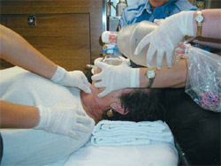
REMEMBER TO CONTINUE RESCUE BREATHING!
Notes:
Remember, before and after the administration of Narcan rescue breathing with a bag-valve-mask should occur.

Slide 17
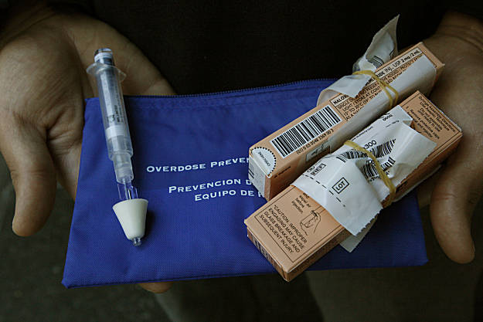
What’s in the BLUE Pouch?
Notes:
So what’s in the blue pouch?

Slide 18
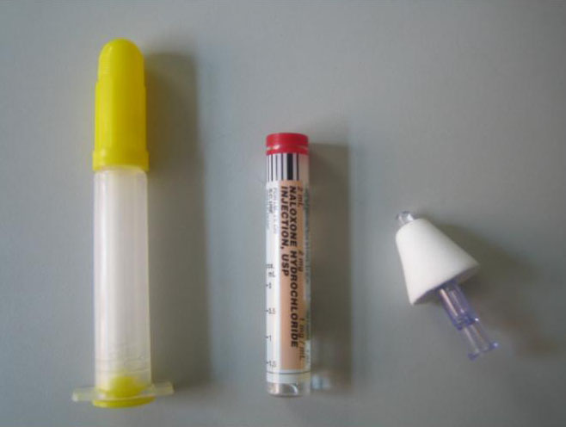
Components of Intranasal NARCAN
Shooter
Glass Vial
Atomizer
Notes:
The shooter, glass vial and atomizer are all located in the blue overdose prevention pouch. In addition, a PCR, the Narcan QA form, directions on post administration, and an index card with the protocol are all in the pouch for quick reference and post administration procedures.

Slide 19
Where is the pouch located?
The Narcan Overdose Kit is located in the inside flap of the AED.
NOTE: Narcan is heat and cold sensitive. The AED should be placed in the passenger compartment in extreme temperatures.
Notes:
The Narcan overdose kit is located in the inside flap of the AED. It is important to note that Narcan and the AED are heat and cold sensitive. In extreme cold or heat, the AED should be secured in the passenger compartment of the car.

Slide 20
How to Assemble Intranasal Narcan
Notes:
How to assemble the Intranasal Narcan device.
Pull or pry off the yellow caps on the shooter.
Remove the red or purple cap off the glass vial.
Grip the clear plastic wings on the atomizer and twist the shooter. Turning it clockwise. Do this gently.
Gently screw glass vial on the larger end of the shooter. Twisting the glass vial clock wise. This only needs to be turned a ¼ to ½ turn. This should be done gently because the glass vial is fragile.
Insert white cone of atomizer in the nostril and administer 1 milligram (1 milliliter) in each nostril.

Slide 21
After the Administration of Narcan
You must complete a pre-hospital care report (PCR).
You must complete a BLS Naloxone Administration Quality Improvement Call Review form.
Return completed paperwork to the EMT unit. Attention: Peter DiPrima within 24-hours of administration.
Restock Narcan at the precinct desk or at the Suffolk County Police Academy EMT Unit.
Notes:
After administration. You must complete a pre-hospital care report (PCR) and a BLS Naloxone Administration Quality Improvement Call Review form.
The completed documents are to be returned completed to the EMT unit. Attention: Peter DiPrima within 24-hours of administration.
Restock Narcan at the precinct desk or at the Suffolk County Police Academy EMT Unit.

Slide 22
Sample Narcan PCR

Slide 23
BLS Naloxone Administration Quality Improvement Call Review Form

Slide 24
Legal Issues Penal Code §220.78
What does the 911 Good Samaritan law do?
The bill includes immunity protections from charge and prosecution for possession of drugs up to an A2 felony offense (possession up to 8 oz. of narcotics); alcohol (for underage drinkers); marijuana (any amount); paraphernalia offenses; and sharing of drugs (in NY sharing constitutes a “sales” offense).
There are some specific drug charges for which there are NO PROTECTION: People in possession of A1 felony amounts of narcotics (NOT marijuana) – this means possessing 8 oz. or more of narcotics – are NOT protected from charge and prosecution.
Notes:
What does the 911 Good Samaritan law do?
The bill includes immunity protections from charge and prosecution for possession of drugs up to an A2 felony offense (possession up to 8 oz. of narcotics); alcohol (for underage drinkers); marijuana (any amount); paraphernalia offenses; and sharing of drugs (in NY sharing constitutes a “sales” offense).
There are some specific drug charges for which there are NO PROTECTION: People in possession of A1 felony amounts of narcotics (NOT marijuana) – this means possessing 8 oz. or more of narcotics – are NOT protected from charge and prosecution.

Slide 25
Legal Issues Penal Code §220.78
Does the law protect against arrest?
In limited circumstances, yes. The new 911 Good Samaritan law protects against arrest for misdemeanor amounts of narcotic drugs (very small and residual amounts), but not misdemeanor amounts of marijuana. For example, possessions up to 3.5 grams of cocaine and up to 3.5 grams of heroin are misdemeanor drug possession offenses.
The original version of the bill proposed protections from arrest for felony narcotic drug possession – but this provision was reduced to only misdemeanor amounts of narcotic drugs in the final negotiations around the legislation.
Notes:
Does the law protect against arrest?
In limited circumstances, yes. The new 911 Good Samaritan law protects against arrest for misdemeanor amounts of narcotic drugs (very small and residual amounts), but not misdemeanor amounts of marijuana. For example, possessions up to 3.5 grams of cocaine and up to 3.5 grams of heroin are misdemeanor drug possession offenses.
The original version of the bill proposed protections from arrest for felony narcotic drug possession – but this provision was reduced to only misdemeanor amounts of narcotic drugs in the final negotiations around the legislation.

Slide 26
Legal Issues Penal Code §220.78
Does the law protect the person if they have a warrant or is on parole or probation?
The law does not provide protection from arrest or charge for drug or alcohol possession if you have an open warrant for your arrest. There is also no specific protection by this bill if you are currently on probation or parole.
Notes:
Does the law protect the person if they have a warrant or is on parole or probation?
The law does not provide protection from arrest or charge for drug or alcohol possession if you have an open warrant for your arrest. There is also no specific protection by this bill if you are currently on probation or parole.

Slide 27
Legal Issues Penal Code §220.78
What happens if I’m accused of selling drugs when I call 911 during an overdose?
The bill includes affirmative defense for sales of a controlled substance or marijuana when the defendant seeks medical help during an overdose situation. This is a defense similar to “self-defense”. This means that if a person is accused of a drug sales crime or a marijuana sales crime because of evidence discovered at the scene of an overdose, they can be acquitted if they prove that they called for medical help during the overdose.
Notes:
What happens if I’m accused of selling drugs when I call 911 during an overdose?
The bill includes affirmative defense for sales of a controlled substance or marijuana when the defendant seeks medical help during an overdose situation. This is a defense similar to “self-defense”. This means that if a person is accused of a drug sales crime or a marijuana sales crime because of evidence discovered at the scene of an overdose, they can be acquitted if they prove that they called for medical help during the overdose.

Slide 28
Legal Issues Penal Code §220.78
What isn’t covered under this law?
Exclusions from this provision: A1 and A2 sales offenses, but the act of seeking medical help during an overdose is included as a mitigating factor for these offenses during sentencing. This means that, in the court proceedings, the defendant can ask the judge to consider, during sentencing, the fact that the defendant called 911 in order to save a life.
Notes:
What isn’t covered under this law?
Exclusions from this provision: A1 and A2 sales offenses, but the act of seeking medical help during an overdose is included as a mitigating factor for these offenses during sentencing. This means that, in the court proceedings, the defendant can ask the judge to consider, during sentencing, the fact that the defendant called 911 in order to save a life.

Slide 29
Legal Issues Penal Code §220.78
Also excluded: the individual cannot be previously convicted for an A1, A2, or B drug felony sales or attempted sales offense.
Notes:
Also excluded: the individual cannot be previously convicted for an A1, A2, or B drug felony sales or attempted sales offense.

Slide 30
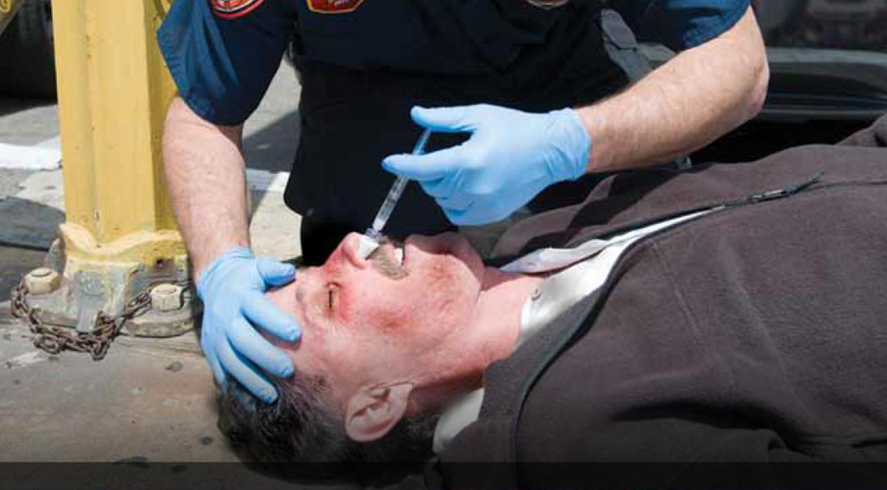
Narcan Saves Lives
Notes:
The administration of Intranasal Narcan from Suffolk County Police Officers has proven to be a success. Narcan saves Lives!

Slide 31
When in doubt contact Medical Control for Medical Direction (631) 689-1430

